Slide 1
MSP430 I2C Module

Slide 2
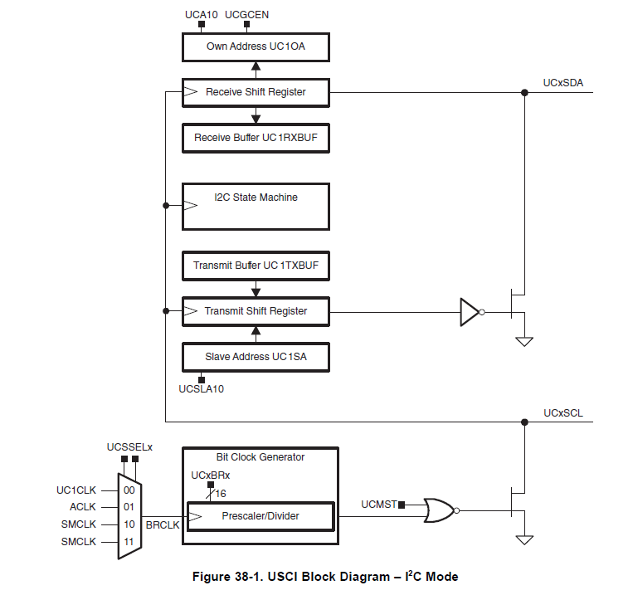
Receive
Transmit
Clock

Slide 3
Block Diagram
UCSLA10 作為從端時addr為7-bit or 10-bit 0=7-bit, 1=10-bit
UCA10 作為從端時addr為7-bit or 10-bit 0=7-bit, 1=10-bit
UCGCEN general call response(作為從端時使用) 0=don’t response, 1=response
UCSSELx choose clock(master) don’t care(slave)
UCMST 0=slave mode, 1=master mode

Slide 4
Initial
2way- 1.重置訊號(PUC) 接收到重置訊號後UCSWRST自動被SET
2.直接SET UCSWRST
在 UCSWRST 被set的期間USCI會維持reset state, 直到準備開始receive or transmit時, Clean UCSWRST
*為避免預期外狀況，UCMODEx只能在UCSWRST set時更動
Reset時reg&line state
1.Communication stop
2.SDA、SCL high
3.UCBxI2CSTAT bit6-0 cleaned
4.Reg UCBxIE & 2UCBxIFG cleaned
5.Other reg remain

Slide 5
Slave mode & master mode
UCSYNC USCI的同步模式or非同步模式 0=非同步， 1=同步 (I2C時設為1)
UCMODEx USCI模式選擇 UCSYNC =1
00: 3-pin SPI
01: 4-pin SPI (UCxSTE active high)
10: 4-pin SPI (UCxSTE active low)
11: I2C
UCMST 選擇MCU為主端還是從端 0=slave, 1=master
*UCTR 選擇現在是傳送還是接收 0=receive, 1=transmit

Slide 6
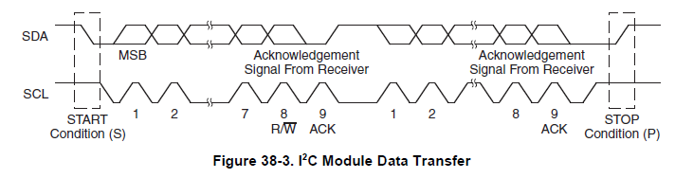
Start & stop
START SCL維持在high時, SDA high->low
STOP SCL維持在high時, SDA low->high
*資料傳輸過程中若發生上述情形可能導致錯誤

Slide 7
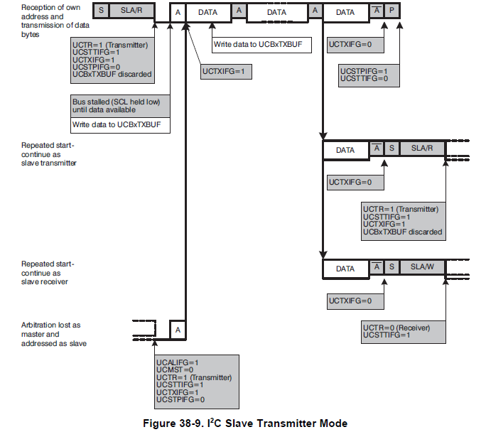
Slave transmitter
(A)
(B)
(C)
(D)?

Slide 8
(A) normal
當MCU作為從端，並收到主端要求的讀取信號後做以下動作:
UCTR SET transmit
UCTXIFG(tx interrupt flag) SET tx interrupt on
UCSTTIFG (state interrupt flag) SET addr match
UCSTPIFG (stop interrupt flag) CLEAN start
UCBxTXBUF load txdata
*等待load txdata完成時SCL拉低為low
2.回傳ACK
3.開始傳送資料

